Slide 1
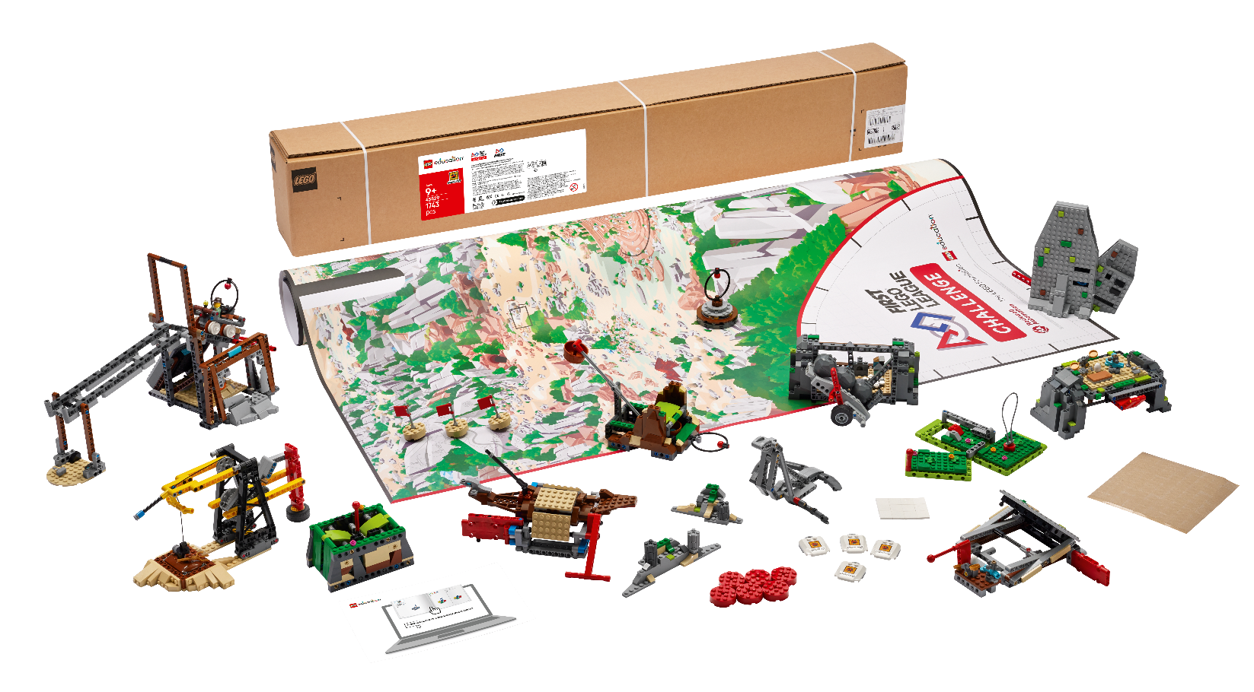


INTRODUCTION
Let’s Get Started

Slide 2

What is FIRST ® LEGO® League Challenge?
Notes:
What is Challenge video
YouTube link: https://youtu.be/bruT6nwLpYE?si=dizkG9tN5J7nqRc7

Slide 3






Core Values
Notes:
FIRST® Core Values ​
The FIRST Core Values are fundamental to FIRST and unique to its programs. They emphasize friendly collaboration, respect for the contributions of others, teamwork, learning, and community involvement and are part of our commitment to fostering, cultivating, and preserving a culture of equity, diversity, and inclusion.
Our community expresses the FIRST philosophies of Gracious Professionalism® and Coopertition® through the FIRST Core Values.

Slide 4
Overview – Core Values
Demonstrate FIRST ® Core Values in everything you do. Your team will be evaluated during the robot game and the judging session.
Your team will:
Apply teamwork and discovery to explore the challenge.
Innovate with new ideas about your robot and project.
Show how your team and your solutions will have an impact and be inclusive!
Celebrate by having fun in everything you do!
Notes:
Challenge slide

Slide 5
Overview – Innovation Project
Your team will prepare a live, engaging presentation to explain the work you have done on your innovation project.
Your team will:
Identify and research a problem.
Design a new solution or improve an existing one based on your selected idea, brainstorming, and plan.
Create a model, drawing, or prototype.
Iterate on your solution by sharing it with others and collecting feedback.
Communicate your solution’s potential impact.
Notes:
Challenge slide

Slide 6
Overview – Robot Design
Your team will prepare a short explanation on your robot design, programs, and strategy.
Your team will:
Identify your mission strategy.
Design your robot and programs and create an effective plan.
Create your robot and programming solution.
Iterate, test, and improve your robot and program.
Communicate your robot design process and everyone’s contributions.
Notes:
Challenge slide

Slide 7
Overview – Robot Game
Your team will have three 2.5-minute matches to complete as many missions as possible.
Your team will:
Build the mission models and set up the field mat.
Review the missions and rules.
Design and build a robot.
Explore building and coding skills while practicing with your robot on the mat.
Compete at an event!
Notes:
Challenge slide

Slide 8
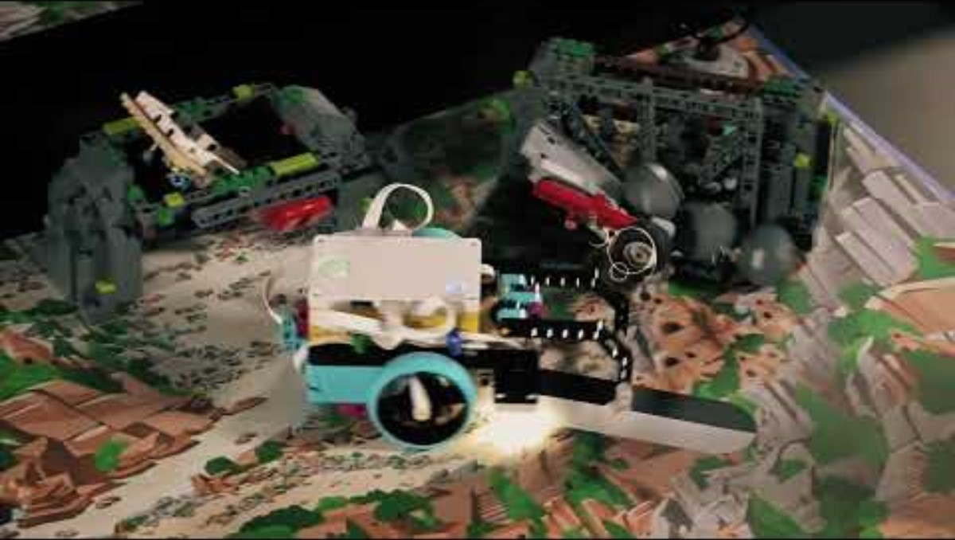

UNEARTHEDTM
UNEARTHEDTM
Visit the FIRST LEGO League YouTube Channel for more videos. Click "Play" to view the 2025-2026 UNEARTHED Season Playlist.

Slide 9
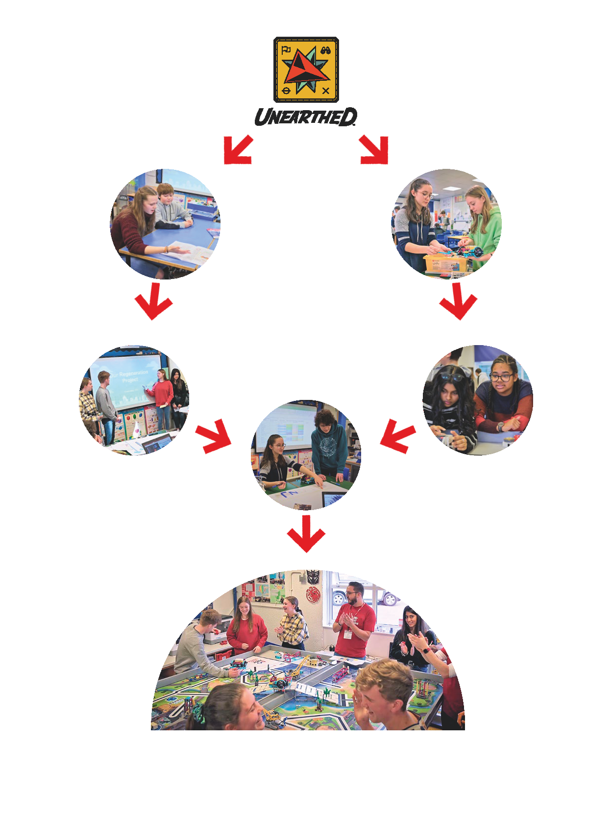
Team Journey
Design Your Innovation Project
Design Your Robot
Use the Engineering Design Process and Core Values
Notes:
Challenge slide

Slide 10
Team Journey
Create Your Innovation Project Solution
Iterate Your Solutions
Create Your Robot Solution
Communicate Your Solutions at Event
Compete in Robot Game
Receive Feedback to Improve
Have Fun and Celebrate
Notes:
Challenge slide

Slide 11
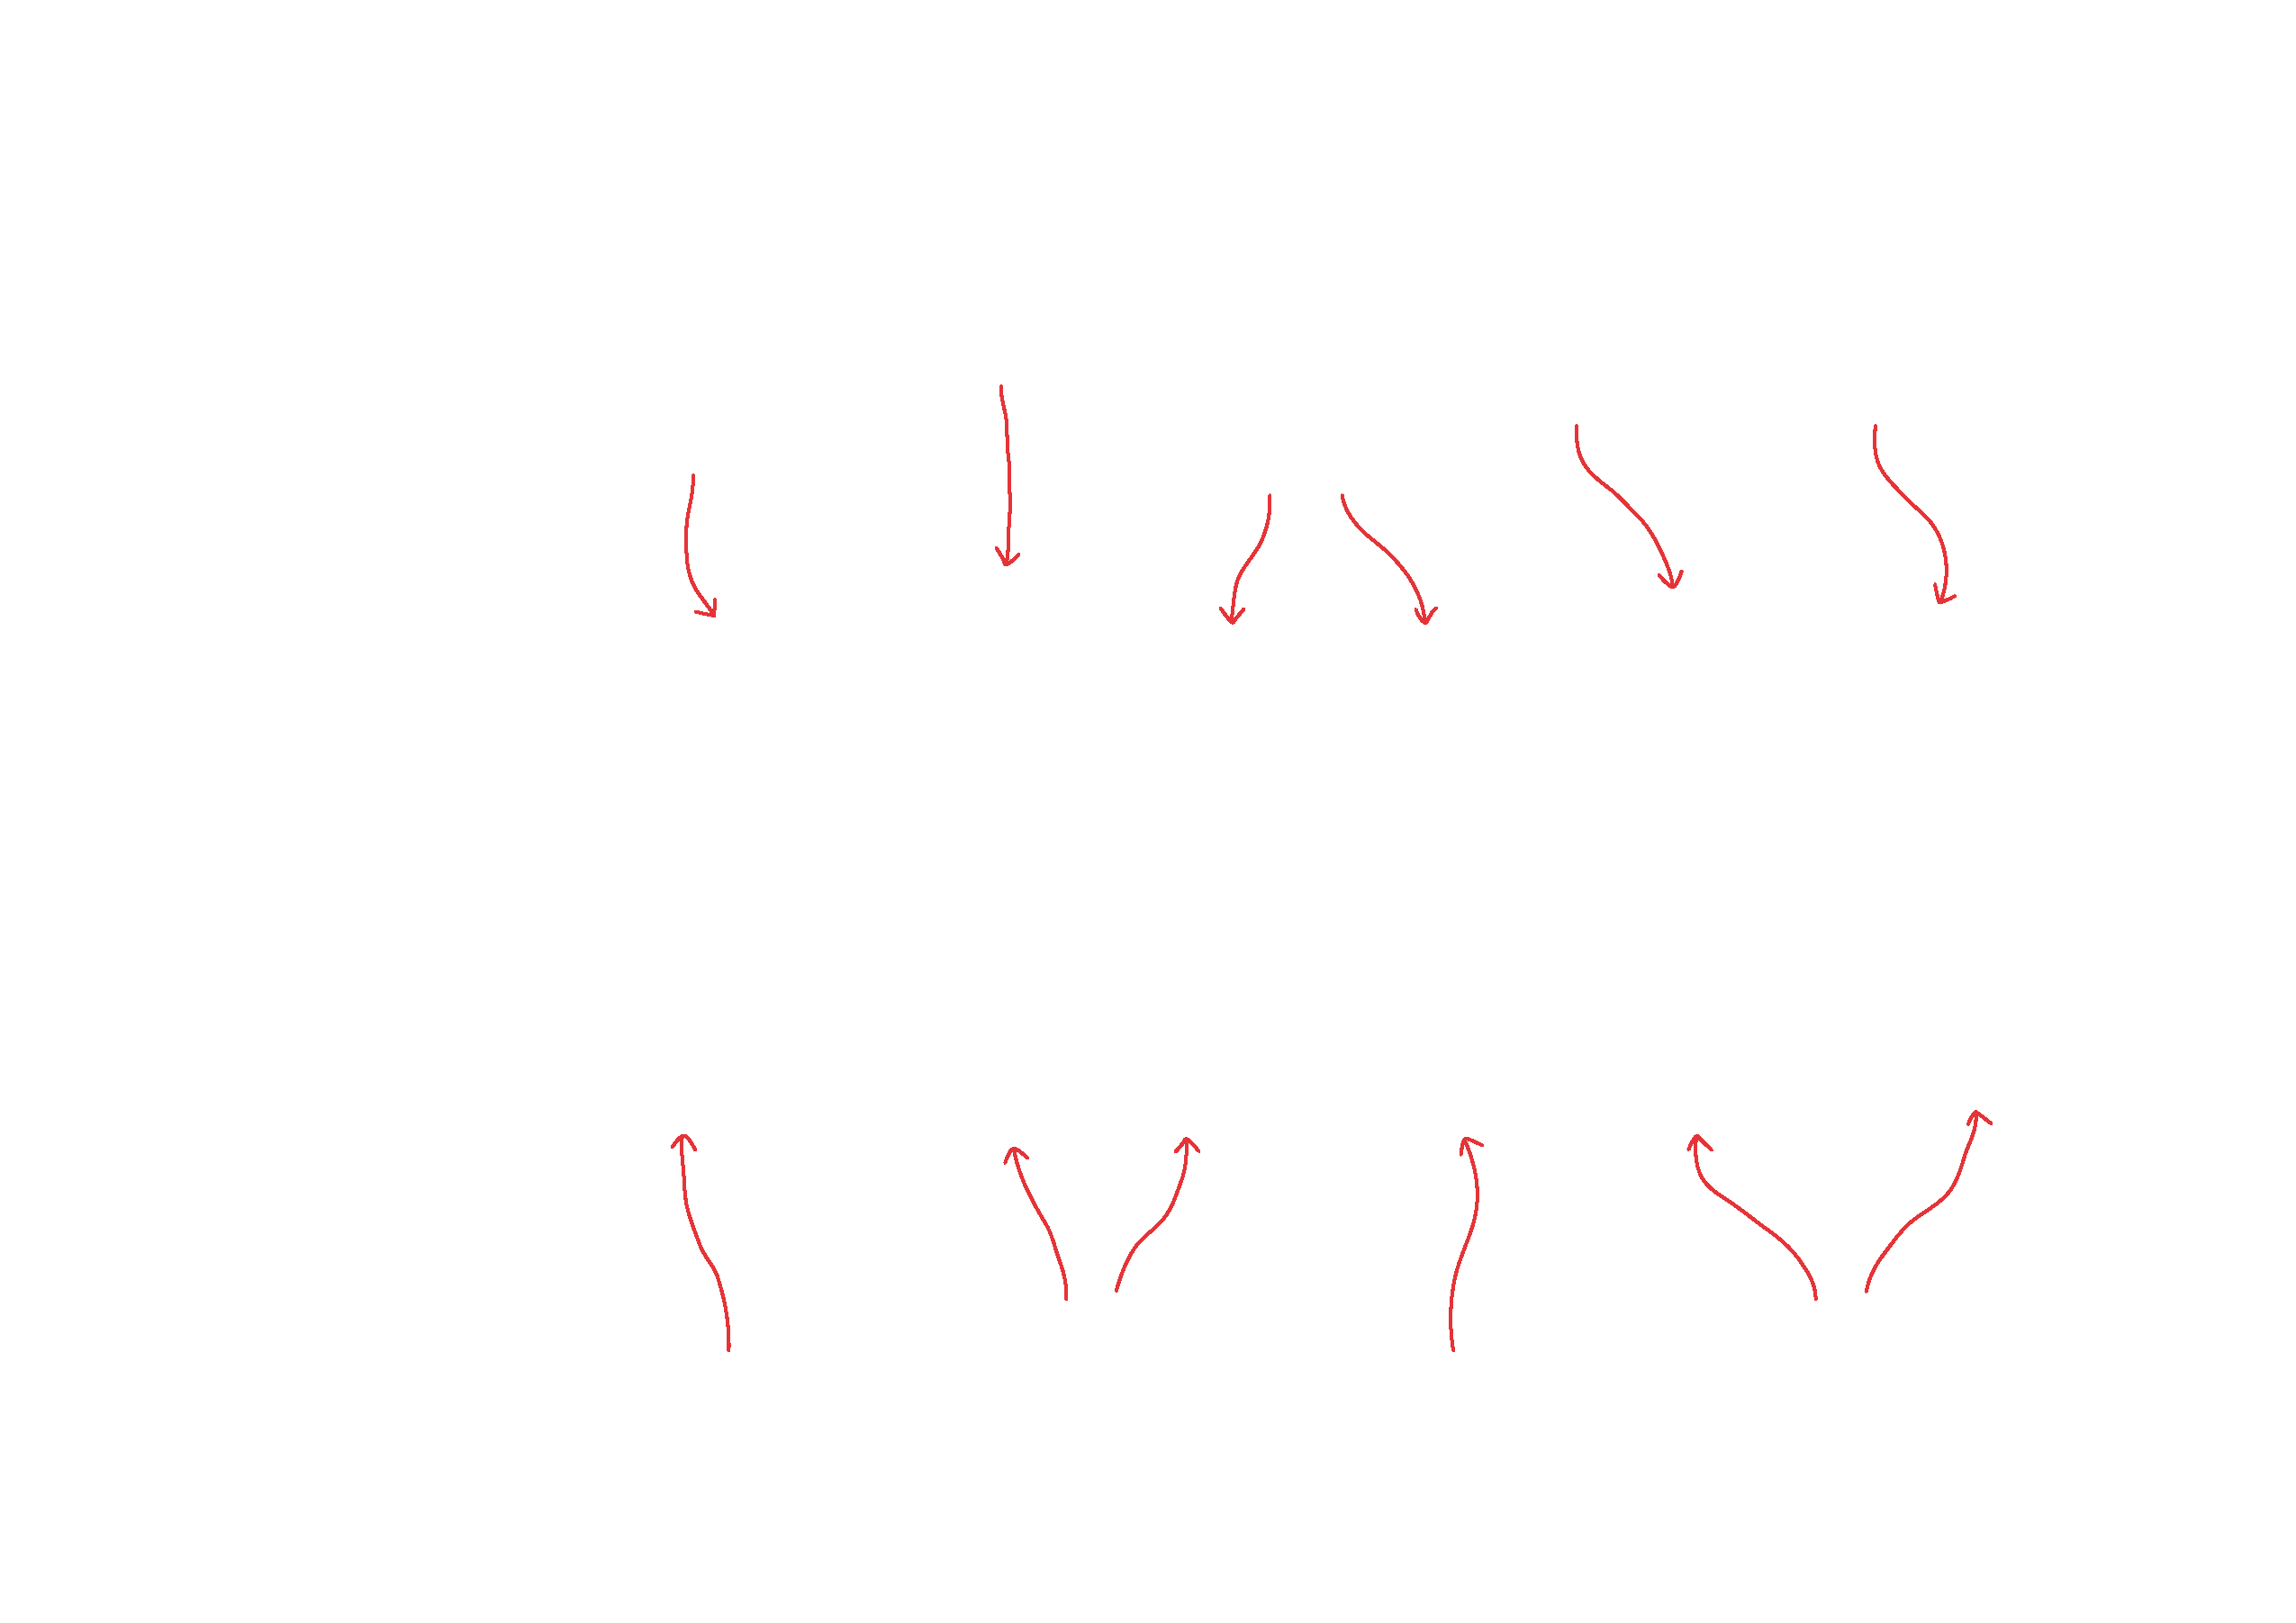
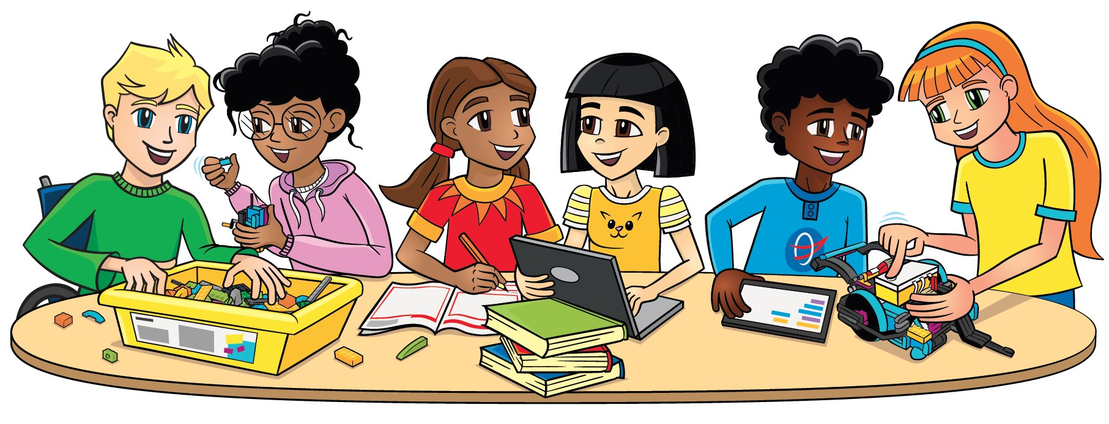
Team Roles
Researcher
Creative Designer
Communicator
Investigates ideas and finds relevant research from different sources to inform the team’s
decision-making.
Creates innovative designs for solutions to be discussed with the
team.
Concentrates on how to
Communicate the team’s work. Writes scripts and prepares presentations.
Team Captain
Project Manager
Shares team progress with facilitator. Ensures session tasks are completed.
Focuses on time management and preparing for the event.
Notes:
Challenge slide

Slide 12
Team Roles
Material Manager
Builder
Mission Strategist
Coder
Gathers and returns materials needed for the session.
Assembles the LEGO mission models following the building
instructions and builds your robot.
Analyzes the Robot Game Rulebook and leads team strategy discussions on which missions to attempt.
Operates the device and creates the programs in the app.
Notes:
Challenge slide

Slide 13
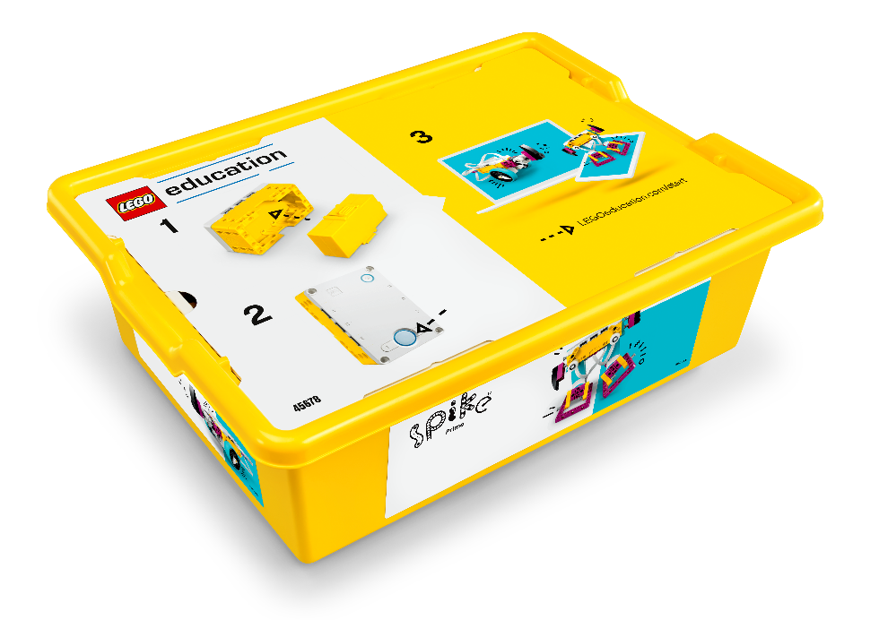

Materials Needed
LEGO® Education SPIKETM Prime Set
Electronic Device
Note: Other LEGO® Education sets such as MINDSTORMS ® and Robot Inventor are also allowed.
Notes:
Challenge slide

Slide 14

Materials Needed
UNEARTHEDTM Challenge Set
The Challenge Set comes in a box that contains the mission models, challenge mat, and 3M™ Dual Lock™ Reclosable Fasteners, coach pins, and season tiles for the team members. The team should build the models very carefully using the building instructions.
Notes:
Challenge slide

Slide 15
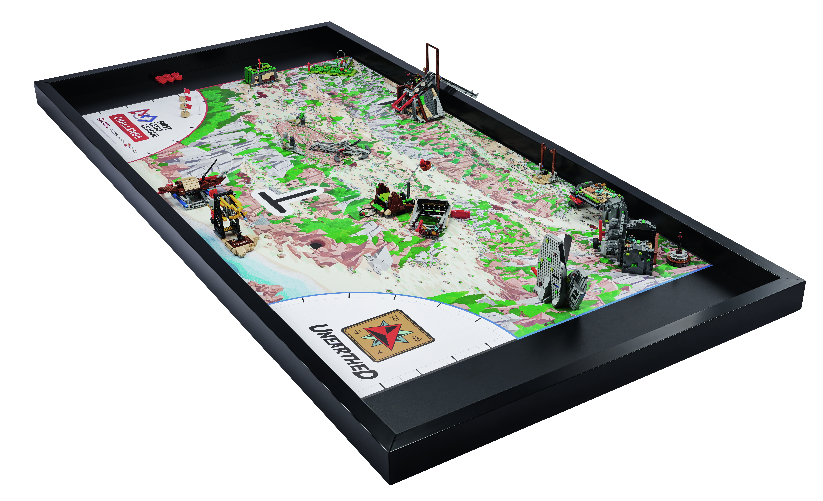
Materials Needed
Challenge Mat and Table
Set up a table with the challenge mat in your classroom or meeting space.
Teams can practice on the mat by placing it on the floor.
However, robot game matches at official events will be played on a table complete with sidewalls.
Instructions to build a table can be found on the Season Resources page.
Notes:
Challenge slide

Slide 16
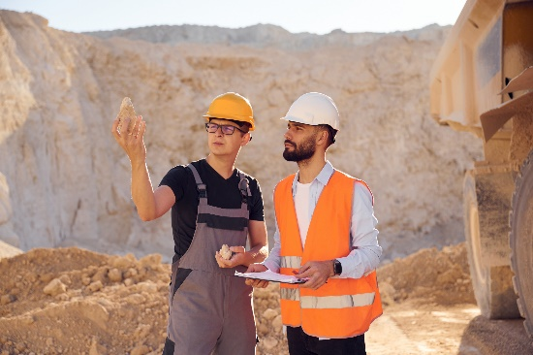
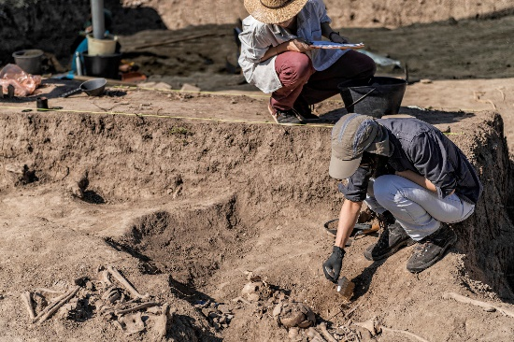
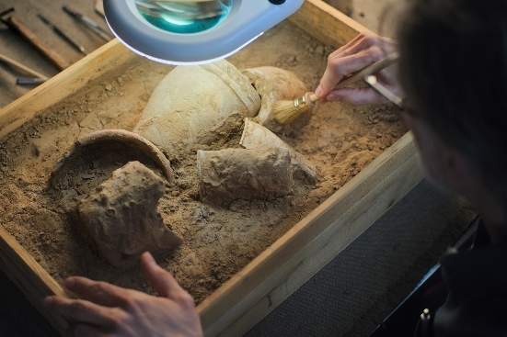
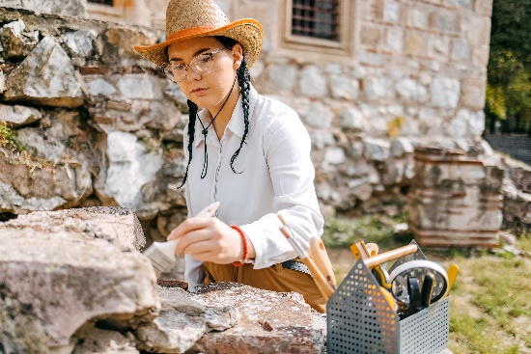
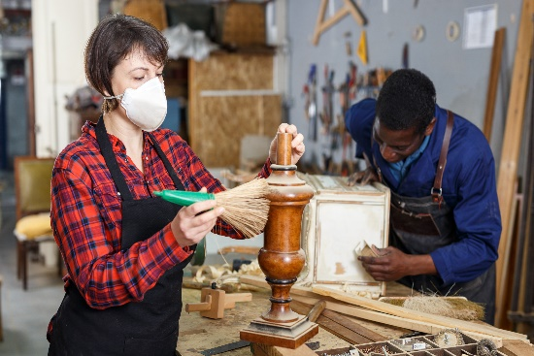
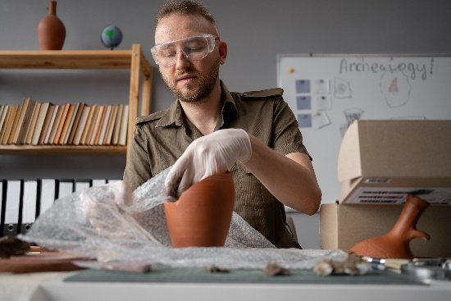
Career Connections
Archaeologist
Lab Technician
Anthropologist
Site Manager
Conservator
Geologist
Notes:
Challenge slide

Slide 17

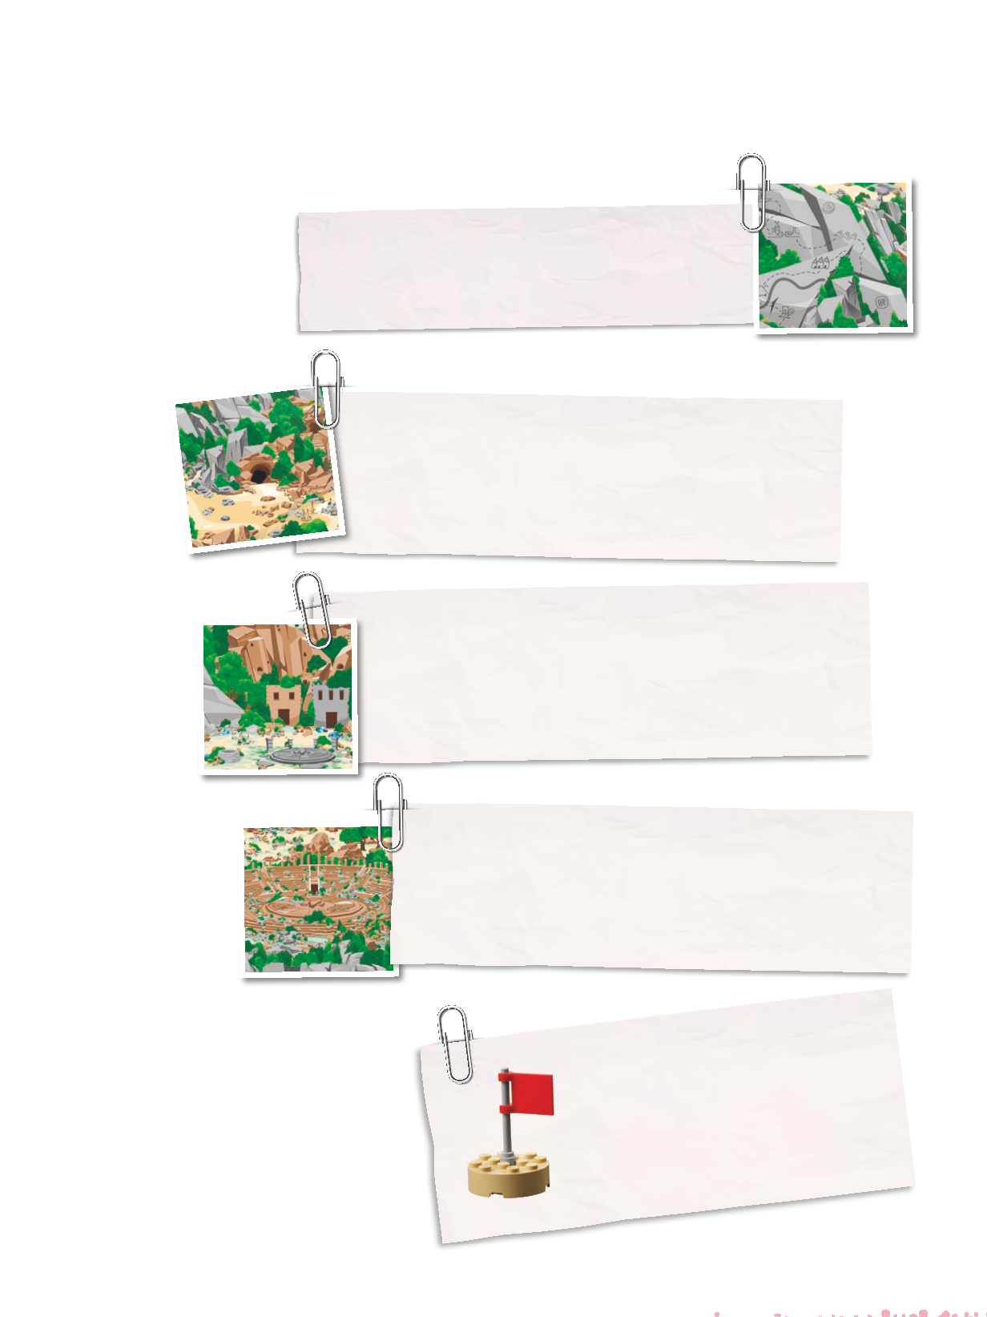
Project Sparks
How will the archaeology team identify where additional artifacts are located?
During an excursion, the team discovers an ancient map leading them to believe more artifacts will be found nearby.
Notes:
Today’s date is the 5th of August, 2025. A team of archaeologists has been documenting their discoveries at a new dig site. Their field notes contain information that is useful for understanding the people who lived here a long time ago.
What solutions exist to solve the problems described in the field notes? Has your team encountered a different problem in the field of archaeology?

Slide 18
Project Sparks
How can the team use technology to create a modern-day map of the cave and full site?
Members of the excavation team want to explore nearby caves and account for changes in the landscape that occurred over time.
Notes:
Today’s date is the 5th of August, 2025. A team of archaeologists has been documenting their discoveries at a new dig site. Their field notes contain information that is useful for understanding the people who lived here a long time ago.
What solutions exist to solve the problems described in the field notes? Has your team encountered a different problem in the field of archaeology?

Slide 19
Project Sparks
What tools can the team use to get these items out of the ground without damaging or losing any of them?
Once excavation begins, the team starts to find artifacts related to everyday life. Some are sturdy and large, like millstones used to process grains, and others are smaller, like coins and beads.
Notes:
Today’s date is the 5th of August, 2025. A team of archaeologists has been documenting their discoveries at a new dig site. Their field notes contain information that is useful for understanding the people who lived here a long time ago.
What solutions exist to solve the problems described in the field notes? Has your team encountered a different problem in the field of archaeology?

Slide 20
Project Sparks
How can the team improve the restoration process?
The archaeologists have evidence that the people who once lived here were very connected to water and all it would provide. Parts of sculptures found near a forum depict animals from the water, but locating all the pieces and restoring them will be a significant challenge.
Notes:
Today’s date is the 5th of August, 2025. A team of archaeologists has been documenting their discoveries at a new dig site. Their field notes contain information that is useful for understanding the people who lived here a long time ago.
What solutions exist to solve the problems described in the field notes? Has your team encountered a different problem in the field of archaeology?

Slide 21
Project Sparks
How can archaeologists work with teams in other careers to solve the mysteries together?
An artifact was discovered that has left everyone on the team wanting to know more, but not every mystery can be solved by one team on its own.
Notes:
Today’s date is the 5th of August, 2025. A team of archaeologists has been documenting their discoveries at a new dig site. Their field notes contain information that is useful for understanding the people who lived here a long time ago.
What solutions exist to solve the problems described in the field notes? Has your team encountered a different problem in the field of archaeology?

Slide 22
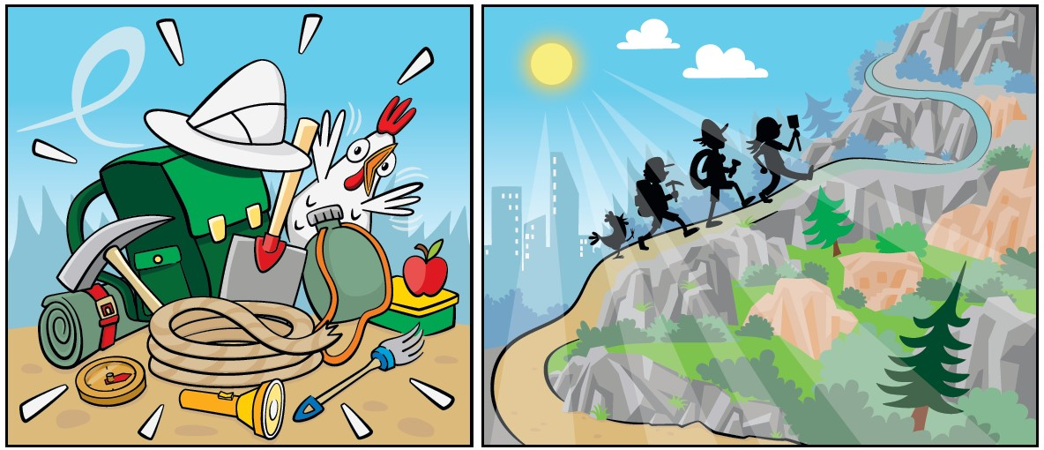
Story

Slide 23
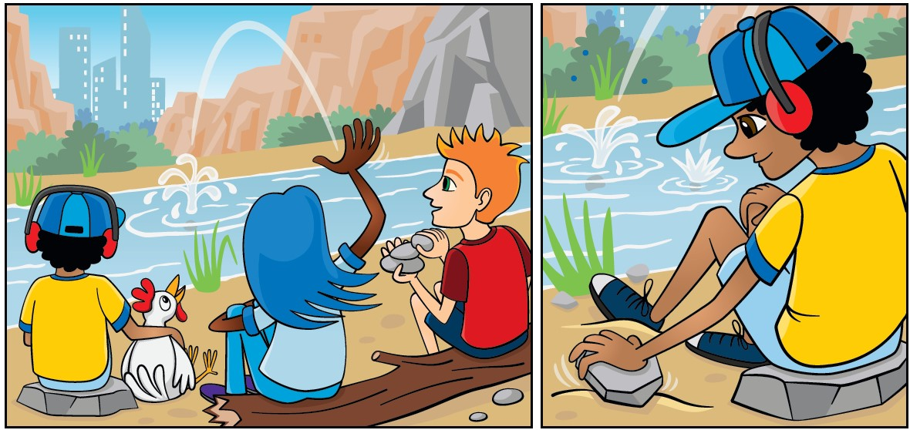
Story

Slide 24
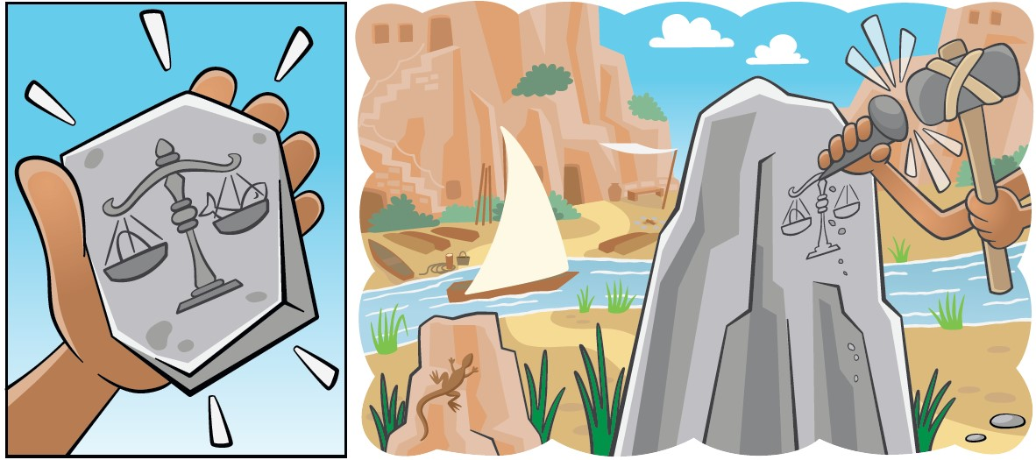
Story

Slide 25
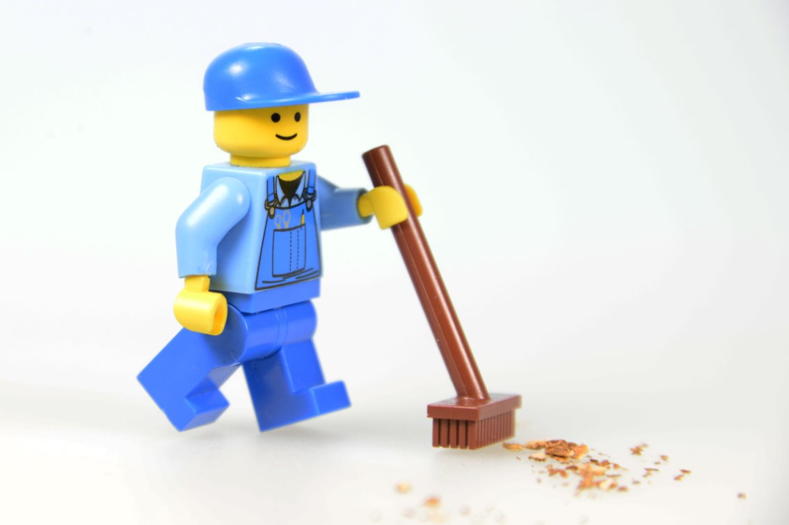
Clean Up

Slide 26


LEGO, the LEGO logo, and the SPIKE logo are trademarks of the/sont des marques de commerce du/son marcas registradas de LEGO Group. ©2025 The LEGO Group. All rights reserved/Tous droits réservés/Todos los derechos reservados. FIRST®, the FIRST® logo, and FIRST® AGE™ are trademarks of For Inspiration and Recognition of Science and Technology (FIRST). LEGO® is a registered trademark of the LEGO Group. FIRST® LEGO® League and UNEARTHED™ are jointly held trademarks of FIRST and the LEGO Group. ©2025 FIRST and the LEGO Group. All rights reserved.

